Slide 1
Chapter 2: Hormones help control the body

Slide 2
2.1 Endocrine system
Much of the work of the endocrine system is concerned with keeping the environment inside the body fairly constant. Maintaining a stable internal environment is known as homeostasis.
Endocrine glands
The endocrine system is made up of the endocrine glands, which secrete hormones. There are two types of glands in the body.
Exocrine glands secrete into a duct that carries the secretion to the body surface or to one of the body cavities. Sweat glands, mucous glands, salivary glands and the glands of the alimentary canal are examples of exocrine glands.
Endocrine glands secrete hormones into the extracellular fluid that surrounds the cells that make up the gland. The secretion then usually passes into the capillaries to be transported by the blood. Endocrine glands are sometimes called ductless glands.

Slide 3
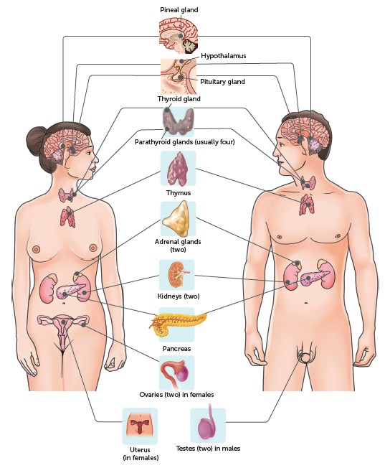
2.1 Endocrine system

Slide 4
2.1 Endocrine system
Hormones
Hormones are chemicals, secreted by endocrine glands, that are transported throughout the body in the blood. They change the functioning of cells by changing the type, activities or quantities of proteins produced. Hormones may:
activate certain genes in the nucleus so that a particular enzyme or structural protein is produced
change the shape or structure of an enzyme so that it is turned ‘on’ or ‘off’
change the rate of production of an enzyme or structural protein by changing the rate of transcription or translation during protein production.
Hormones can only influence cells that have the correct receptor for the hormone. Therefore, a hormone may affect:
all the cells of the body
only particular groups of cells, target cells
only particular organs, target organs.
Hormones may be steroids, proteins or amines.

Slide 5
2.1 Endocrine system
Steroid hormones
Steroid hormones, such as oestrogen, progesterone, cortisol and aldosterone, are lipid-soluble, meaning they do not dissolve in water. Once they are released into the blood, the hormones bind to transport proteins, enabling them to travel in the bloodstream. When they reach the target cells, the steroid hormones separate from the transport proteins and diffuse across the cell membrane.
Inside the cell they work by combining with a receptor protein in the cytoplasm or nucleus. The hormone–receptor complex activates the genes controlling the formation of particular proteins. It does this by binding to the promoter section of a certain gene, stimulating (or inhibiting) transcription and, therefore, protein synthesis. Steroid hormones are slow to have an effect, but the effect is long lasting.

Slide 6
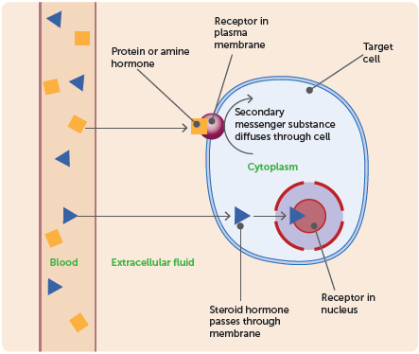
2.1 Endocrine system
Protein and amine hormones
Protein and amine hormones are water-soluble. Because they are not lipid soluble, they are unable to diffuse across the cell membrane. Instead, they work by attaching to receptor proteins in the membrane of the target cell. The combination of the hormone with the receptor causes a secondary messenger substance to diffuse through the cell and activate particular enzymes. For example, the hormone insulin binds to a receptor protein and this leads to an increase in glucose absorption by the cell. Protein and amine hormones tend to be quick to cause a response; however, the effect is short lasting.

Slide 7
2.1 Endocrine system
Hormone receptors
Receptor proteins are specific. Each type of receptor will bind with only one specific molecule. The lock and key analogy can be used to describe this interaction. The lock, the receptor protein, will only work with the correct key, the binding molecule.
There are a limited number of receptor proteins in the membrane of each cell. When each receptor is bound to a molecule, there can be no further increase in the rate of the cell’s activity.
For example, when each insulin receptor in the cell membrane is bound to insulin, the cell’s rate of glucose uptake cannot increase any further, even if the amount of insulin increases. This means that saturation can occur; once all the receptor molecules are occupied by hormone molecules, the addition of more hormones does not produce any greater effect.
Different cells have different types and numbers of receptor proteins. This is why there is variation in the sensitivities of cells to hormones and other substances.

Slide 8
2.1 Endocrine system
Enzyme amplification
One hormone molecule does not cause the manufacture or activation of just one molecule of an enzyme – it activates thousands of molecules. This is achieved through a process called enzyme amplification. The hormone triggers a cascading effect in which the number of reacting molecules involved is increased hundreds or thousands of times for each step along the metabolic pathway. One hormone molecule could trigger the production of more than a billion enzyme molecules. Therefore, a very small stimulus can produce a very large effect.
Hormone clearance
Once a hormone has produced the required effect, it must be turned off. This is done by breaking down the hormone molecules. Some hormones are broken down in the target cells, but most are broken down in the liver and the kidneys. The degraded hormones are then excreted in either the bile or the urine.

Slide 9
2.1 Endocrine system
Control of hormone secretions
To maintain homeostasis, the amount of hormone produced by an endocrine gland must be very closely regulated. Any oversecretion or undersecretion of a hormone will cause the body to function abnormally.
Hormonal secretions are generally regulated by negative feedback systems whereby the response produced by the secretion of the hormone is the opposite of the stimulus that caused the secretion.

Slide 10
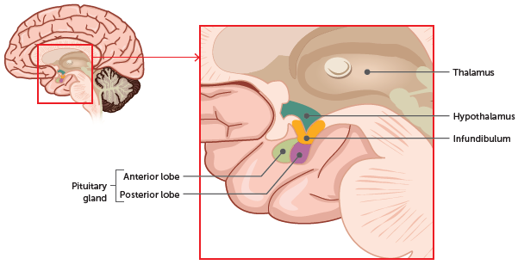
2.2 Hypothalamus and pituitary gland
The hypothalamus and pituitary gland work together to control the functioning of many of the other glands.
Hypothalamus
The hypothalamus has roles in both the nervous and endocrine systems and serves as a connection between the two systems. It regulates many of the basic functions of the body, such as body temperature, water balance and heart rate, in addition to increasing or decreasing the secretions of other glands.
The hypothalamus is located at the base of the brain, below the thalamus and above the pituitary gland. It is about the size of an almond.

Slide 11
2.2 Hypothalamus and pituitary gland
Many of the functions of the hypothalamus are carried out through the pituitary gland.
The hypothalamus secretes releasing factors, which stimulate the secretion of a hormone, or inhibiting factors, which slow down the secretion of a hormone. These factors travel through blood vessels to the anterior lobe of the pituitary gland, affecting the secretion of its hormones.
Other hormones are produced by the hypothalamus and pass along the nerve fibres to the posterior lobe of the pituitary gland where they are then released.

Slide 12
2.2 Hypothalamus and pituitary gland
Pituitary gland
The pituitary gland, or hypophysis, lies just under the hypothalamus and is joined to the hypothalamus by a stalk called the infundibulum. It is only about 13 mm in diameter, but is absolutely vital to the normal functioning of the body.
It consists of an anterior lobe and a posterior lobe, each of which functions separately. The anterior (front) lobe has no nerves connecting it to the hypothalamus; rather, they are connected by a complex network of blood vessels lying in the infundibulum. The posterior (rear) lobe is joined to the hypothalamus by nerve fibres that come from nerve cell bodies in the hypothalamus and pass through the infundibulum to the posterior lobe. It is not a true endocrine gland because it does not secrete substances. Instead, it simply stores and releases hormones.

Slide 13
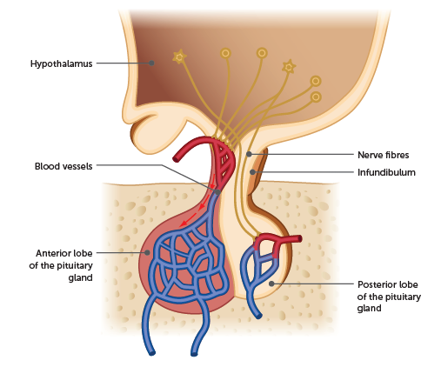
2.2 Hypothalamus and pituitary gland

Slide 14
2.2 Hypothalamus and pituitary gland
Anterior lobe
The anterior lobe of the pituitary gland (the adenohypophysis) releases a number of hormones that regulate a great range of bodily activities. Secretions of the anterior lobe are in turn controlled by releasing and inhibiting factors secreted by the hypothalamus.
The following hormones are released by the anterior lobe of the pituitary gland:
Gonadotropins – follicle-stimulating hormone (FSH) and luteinising hormone (LH)
Growth hormone (GH), or somatotropin
Thyroid-stimulating hormone (TSH)
Adrenocorticotropic hormone (ACTH)
Prolactin (PRL).

Slide 15
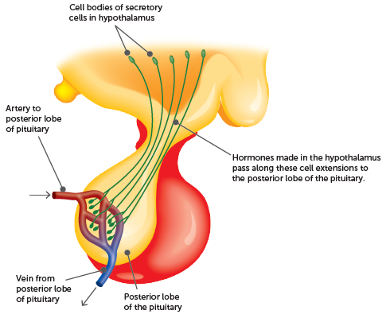
2.2 Hypothalamus and pituitary gland
Posterior lobe
The posterior lobe of the pituitary gland (the neurohypophysis) releases the hormones oxytocin and antidiuretic hormone, but neither is manufactured in the posterior lobe. Both hormones are produced in special nerve cells in the hypothalamus of the brain. These cells have long extensions that pass through the infundibulum to the posterior lobe. Hormones manufactured in the cells move down the extensions and are stored ready for release into the bloodstream. The release of the hormones is triggered by nerve impulses initiated in the hypothalamus and conducted along the cell extensions.

Slide 16
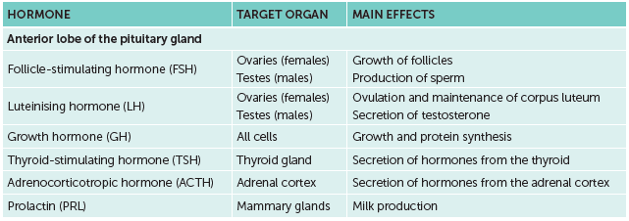

2.2 Hypothalamus and pituitary gland
Summary of hormones released by the pituitary gland

Slide 17
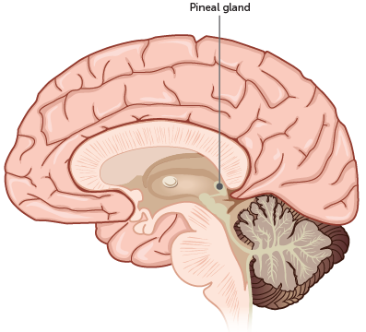
2.3 Other endocrine glands
Pineal gland
The pineal gland is found deep inside the brain. In children it is about the size of a pea. After puberty it gradually decreases in size. Its role remains something of a mystery, but it is known that it secretes the hormone melatonin, which is involved in the regulation of sleep patterns. Production of melatonin by the pineal gland is stimulated by darkness and inhibited by light.

Slide 18
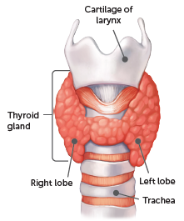
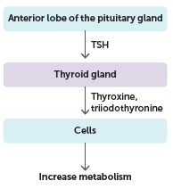
2.3 Other endocrine glands
Thyroid gland
The thyroid gland is located in the neck, just below the larynx. It consists of two lobes that lie on either side of the trachea and are joined by a narrow piece of tissue that lies across the front of the trachea.
The follicular cells in the thyroid gland secrete two hormones in response to thyroid stimulating hormone: thyroxine (or T4) and triiodothyronine (or T3).
Thyroxine controls body metabolism by regulating reactions in which complex molecules are broken down to release energy, and other reactions in which complex molecules are synthesised from simple ones. The overall effect of thyroxine is to bring about the release of energy and, because some of the energy released is in the form of heat, to maintain body temperature.
The thyroid gland also plays a role in regulating the levels of calcium and phosphate in the blood through the release of calcitonin by C-cells.
Location of thyroid gland
Thyroxine production

Slide 19
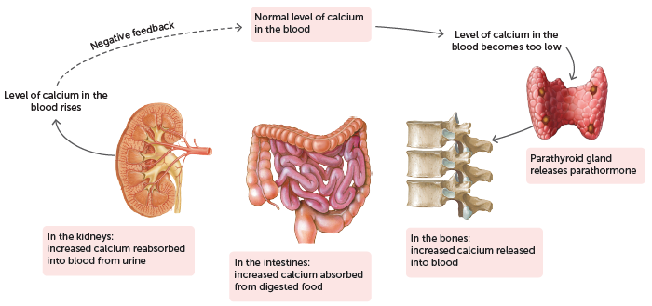
2.3 Other endocrine glands
Parathyroid gland
The parathyroid glands are located in the rear surface of the lobes of the thyroid gland. There are usually four parathyroid glands, although some people have more. Each is about the size of a small pea.
The parathyroid glands secrete parathyroid hormone (PTH, or parathormone), which increases calcium levels in the blood and phosphate excretion in the urine.
The regulation of blood calcium level by parathyroid hormone

Slide 20
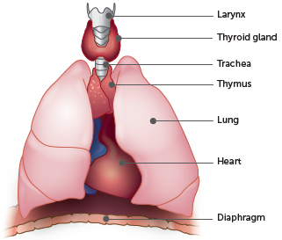
2.3 Other endocrine glands
Thymus
The thymus is located in the chest just above the heart and just behind the sternum. Like the pineal gland, the thymus is largest in infants and children, and begins to shrink after puberty. The thymus secretes a group of hormones called thymosins. These hormones influence the maturation of disease-fighting cells called T-lymphocytes.
Location of the thymus

Slide 21
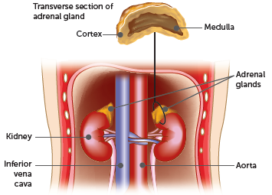
2.3 Other endocrine glands
Adrenal glands
There are two adrenal glands, one immediately above each kidney. Each adrenal gland has an inner adrenal medulla and an outer adrenal cortex. These two parts are quite different in their structure and function, therefore each adrenal gland is really two separate endocrine glands.
Location of the adrenal glands

Slide 22
2.3 Other endocrine glands
Adrenal medulla
The hormones produced by the adrenal medulla are adrenaline and noradrenaline.
Adrenaline, also called epinephrine, has an effect similar to that of the sympathetic division of the autonomic nervous system. Adrenaline helps to prepare the body for reaction to a threatening situation (fight-or-flight response).
Noradrenaline, also called norepinephrine, has effects similar to those of adrenaline. In particular, it increases the rate and force of the heartbeat.

Slide 23
2.3 Other endocrine glands
Adrenal cortex
More than 20 different hormones are produced in the adrenal cortex and they are known collectively as corticosteroids. The two main ones are:
aldosterone, which acts on the kidney to reduce the amount of sodium and increase the amount of potassium in the urine
cortisol, which, with related hormones, promotes normal metabolism, helping the body to withstand stress and to repair damaged tissues.

Slide 24
2.3 Other endocrine glands
Pancreas
The pancreas is a soft organ approximately 15 cm long. It lies just below the stomach and alongside the duodenum, the first part of the small intestine.
The pancreas is both an exocrine gland and an endocrine gland. The exocrine part secretes digestive enzymes into the small intestine through the pancreatic duct. The endocrine part is made up of clusters of special cells called islets of Langerhans (also called pancreatic islets). These cells secrete two important hormones:
Insulin is secreted by the beta cells of the islets of Langerhans. It reduces the amount of glucose in the blood (the blood sugar level).
Glucagon, secreted by the alpha cells of the islets of Langerhans, acts in the opposite way to insulin. It works to increase the blood glucose level. It also stimulates the breakdown of fat in the liver and in fat storage tissues.

Slide 25
2.3 Other endocrine glands
Gonads
The gonads are the testes and the ovaries. As well as their role in the reproductive system, with their production of sperm and eggs, they are also a part of the endocrine glands due to their production of hormones.
Androgens – for example, testosterone – are known as the male sex hormones. They are responsible for the development and maintenance of the male sex characteristics, and are produced by the testes.
Oestrogens and progesterone are the female sex hormones produced by the ovaries. They stimulate the development and maintenance of the female sex characteristics. Together with the gonadotropic hormones of the pituitary, they also regulate the menstrual cycle and are involved in changes that occur during pregnancy.

Slide 26
2.3 Other endocrine glands
Other endocrine tissues
There are other tissues, many of which are not called endocrine glands, that secrete hormones.
The stomach and small intestine both secrete hormones that coordinate the exocrine glands of the digestive system.
The kidneys secrete hormones, including erythropoietin (EPO) – a hormone that stimulates production of red blood cells by the bone marrow.
The heart secretes a hormone that helps to reduce blood pressure.
The placenta secretes a number of hormones during pregnancy that help to maintain the pregnancy, stimulate development of the foetus and stimulate the mother’s mammary glands.

Slide 27
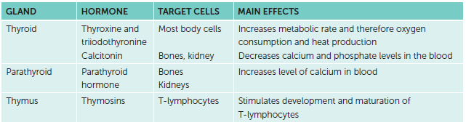
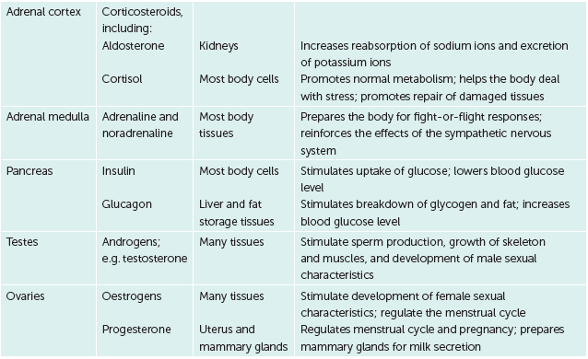
2.3 Other endocrine glands
Hormones produced by endocrine glands other than the pituitary gland

